Slide 1

Grade
K
Quarter 1 Pre-Assessment
Listening Comprehension
Teacher Directions
Sequential Steps toward Standard Mastery.
Reading
12 Selected-Response Items
Research
0 Constructed-Response Items (3 point item)
Writing
0 Brief Write
0 Write to Revise a Text
0 Full Composition
Writing w/Integrated Language as part of the Performance Task
Language/Vocabulary
Edit/Clarify
Performance Task
at Grade Level.

Slide 2
Grade
K
Quarter One
Pre-Assessment
Reading: Literature
Targets |  | Standards | DOK
1 | Key Details | RL.1 RL.3 (can move to DOK-3) | 1-2
2 | Central Ideas | RL.2 | 2
Reading: Informational
Targets |  | Standards | DOK
8 | Key Details | RI.1 RI.3 (can move to DOK-3) | 1-2
9 | Central Ideas | RI.2 | 2
Writing NOT ASSESSED until end of Quarter One on CFA
Targets |  | Standards | DOK
6a | Brief Opinion Write | W-1a, W-1b, W-1c, W-1d, W-8 | 3
6b | Write-Revise Opinion | W-1a, W-1b, W-1c, W-1d, W-8 | 2
8 | Language-Vocabulary Use | L.6 | 1-2
9 | Edit and Clarify | L.2d | 1-2

Slide 3

All elementary ELA assessments were reviewed and revised in June of 2015 by the following amazing and dedicated HSD K-6th grade teachers.
Deborah Alvarado Lincoln Street | Ko Kagawa Minter Bridge
Linda Benson West Union | Jamie Lentz Mooberry
Anne Berg Eastwood | Sandra Maines Quatama
Aliceson Brandt Eastwood | Gina McLain TOSA
Sharon Carlson Minter Bridge | Teresa Portinga Patterson
Deborah Deplanche Patterson | Judy Ramer Consultant
Alicia Glasscock Imlay | Sara Retzlaff McKinney
Sonja Grabel Patterson | Jami Rider Free Orchards
Megan Harding Orenco | Kelly Rooke Free Orchards
Renae Iversen TOSA | Angela Walsh Witch Hazel
Ginger Jay Witch Hazel

Slide 4
Order at HSD Print Shop…
http://www.hsd.k12.or.us/Departments/PrintShop/WebSubmissionForms.aspx
Directions
The HSD Elementary assessments are neither scripted nor timed assessments. They are a tool to inform instructional decision making.
All students should “move toward” taking the assessments independently but many will need scaffolding strategies.
It is not the intent of these assessments to have students “guess and check” answers for the sake of finishing an assessment. If that seems the case, please scaffold to gain a true understanding of student ability, noting when and what accommodations were needed.
Connecting Assessment to Classroom Instruction
How do the assessments connect to classroom instruction? Assessment is not an isolated event. The HSD assessments are an extension of classroom instruction. In the classroom assessment is on-going and monitors progress toward standards mastery.
Assessment Components as a Routine Classroom Practices
Assessment Components | Instructional Components
Pre-Assessments | Use the DOK Leveled Learning Progression Tasks to monitor standard mastery.
Standard DOK Level
50% Literary and 50% Informational Text | Students have equal access to both text types.
Grade Level Content-Rich Text | All students read grade-level text, content rich text (with scaffolds as needed).
Standard Academic Vocabulary Content-Domain Vocabulary. | Ask questions using the standard’s vocabulary as well as the content domain vocabulary.
Text –Dependent Questions | Ask text-dependent questions from the standard’s DOK level.
Selected and Constructed Responses | Students have many opportunities to answer selected extended or constructed responses.
Reading for Meaning | Assess understanding using never before seen text (although the theme or topic should be grade-level “friendly” or familiar) and reading rubrics.
Note-Taking | Students “take notes” as they read to identify the central or main idea and its supporting details.
SBAC Reading/Writing Rubrics | Use SBAC rubrics to access reading/writing.
Read to Write Evidenced-Based Model | Students read, discuss and write about a topic using evidence from the text to support inferences, conclusions and generalizations.
Write and Revise | Students revise brief texts, correct grammar and language/vocabulary in context and write brief texts (brief write rubrics should be used).
Performance Tasks | Students read, write, discuss and research a topic guided by a central insight or goal throughout a unit(s) of study with fully defined criteria, culminating in a final product or “performance task.” The final product can be a full composition, speech (using SBAC Rubrics) or other product meeting all criteria.

Slide 5
Pre-Assessment and Learning Progressions
The pre-assessments are unique.
They measure progress toward a standard.
Unlike the Common Formative Assessments which measure standard mastery, the pre-assessments are more like a base-line picture of a student’s strengths and gaps, measuring skills and concepts students need “along the way,” in order to achieve standard mastery.
So what about a “post-assessment?” There is not a standardized post-assessment.
The true measure of how students are doing “along the way,” is assessed in the classroom during instruction and classroom formative assessment. For this reason The CFA’s are not called “post-assessments.” The CFAs measure the “end goal,” or standard mastery. However, without the pre-assessments, how will we know what our instruction should focus on throughout each quarter?
Learning Progressions: are the predicted set of skills needed to be able to complete the required task demand of each standard. The learning progressions were aligned to Hess’ Cognitive Rigor Matrix.
The pre-assessments measure student proficiency indicated on the boxes in purple (adjustment points). These points are tasks that allow us to adjust instruction based on performance. For instance, if a student has difficulty on the first “purple” adjustment point (DOK-1, Cf) the teacher will need to go back to the tasks prior to DOK-1 Cf and scaffold instruction to close the gap, continually moving forward to the end of the learning progression.
There is a Reading Learning Progression checklist for each standard in each grade that can be used to monitor progress. It is available at:
Beg. of QTR
CFA
RL.2.1 grade-level standard assessment.
END of QTR
Example of a Learning Progression for RL.2.1
Pre-Assessments Measure Adjustment Points (in purple)
Throughout the QTR
After the pre-assessment is given, Learning Progressions provide informal formative assessment below and near grade-level “tasks” throughout each quarter.
DOK 1 - Ka | DOK - Kc | DOK 1 - Cd | DOK 1 - Cf | DOK 2 - Ch | DOK 2 - Ck | DOK 2 -Cl | Standard Mastery
Recall who, what, where, when, why and how about a story read and discussed in class. | Use and define Standard Academic Language: who, what, where, when, why, and how; ask, answer, questions, key details | Connect the terms who to characters; where and when to setting; what and how to sequence of events. | Ask and answer who, what, where, when, why and how questions about key details in a text. | Concept Development Student understands that key details help tell who, what, where, when, why and how. | Uses key details to identify who, what, where, when, why and how about a story not read in class. | Finds information using key details to answer specific questions about a new story. | RL.2.1 Ask and answer such questions as who, what, where, when, why, and how to demonstrate understanding of key details in a text
http://sresource.homestead.com/Grade-2.html

Slide 6
Quarter One Reading Literature Learning Progressions.
The indicated boxes highlighted before the standard, are assessed on this pre-assessment. The standard itself is assessed on the Common Formative Assessment (CFA) at the end of each quarter.
DOK 1 -Ka | DOK 1 -Kc | DOK 1 - Cf | DOK 2 -Ch | DOK 2 -Ci | DOK 2 -Cl | Standard
Recall details in a story the teacher has read to and discussed with the class (rote memory). | Understands the Standard Academic Language: ask, answer, questions and key details. | Answers and asks questions that ask who, what, where, when, or how about texts read to and discussed in class. NOT ASSESSED | Concept Development Recognizes that different question words required specific responses. | Summarize a sequence of events from a text read to in class. SELECTED RESPONSE | Answers and asks questions referring to specific details in a text read to in class (new questions not discussed in class). SELECTED RESPONSE | RL.K.1 With prompting and support, ask and answer questions about key details in a text
DOK 1 - Ka | DOK 1 - Kc | DOK 1 - Cf | DOK 2 - Ch | DOK 2 - Ci | DOK 2 - Cl | Standard
Recalls details about a story read to and discussed in class (details about characters, settings and events), (rote memory). | Understands the Standard Academic Language: familiar, stories, key details, details and retell. | Describe or explain (by telling or answering) key details or events in a story using who, what, where, why, and how. NOT ASSESSED | Concept Development Understands that key details can help retell a story. | Summarizes a familiar story read to in class using key details (can do with little prompting or support). SELECTED RESPONSE | Locates key details in order to answer questions about a familiar story. SELECTED RESPONSE | RL.K.2 With prompting and support, retell familiar stories, including key details
DOK 1 - Ka | DOK 1 - Kc | DOK 1 - Cd | DOK 1 - Cf | DOK 2 - Ch | Standard-DOK-2 APn
Recall characters, settling beginning, middle and ending events in a story read and discussed in class. | Define the terms (know the meanings of) Standard Academic Language: story, character, setting , major and event. | Identify specific characters, setting and event sequences in a new- (i.e., not a well-known traditional story), (read and discussed in class). NOT ASSESSED | Answer describing questions about characters, setting or events in a story read and discussed in class. SELECTED RESPONSE | Connects story events to a specific character or setting. SELECTED RESPONSE | RL.K.3 With prompting and support, identify characters, settings, and major events in a story (read but not discussed in class)

Slide 7
Quarter One Reading Informational Learning Progressions.
The indicated boxes highlighted before the standard, are assessed on this pre-assessment. The standard itself is assessed on the Common Formative Assessment (CFA) at the end of each quarter.
DOK 1 -Ka | DOK 1 - Kc | DOK 1 - Ce | DOK 1 - Cf | DOK 2 -Ch | DOK 2 - Ci | DOK 2 -Cl | Standard- DOK 2
Recall details in a text the teacher has read to and discussed with the class (rote memory). | Defines and Understands the Standard Academic Language: ask, answer, questions and key details. | Identifies where to find information in an expository text (title, headings, pictures, cover, etc...). | Answers questions that ask who, what, where, when, or how about an informational text read to and discussed in class. NOT ASSESSED | Concept Development Understands that key details in a text support (tell us about) what the text is all about. | Summarize a sequence of events. SELECTED RESPONSE | Asks and answers questions about a text read to in class using key details from the text (can do with little previous discussion). SELECTED RESPONSE | RI.K.1 With prompting and support, ask and answer questions about key details in a text.
DOK 1 - Ka | Dok 1 - Kc | Dok 1 - Cf | DOK 2 - Ch | DOK 2 -Ck | DOK 2 - Cl | Standard DOK 2 – Cl
Recall details from an informational text read to and discussed in class. | Define the terms (know the meanings of) Standard Academic Language: identify, main, topic, “main topic,” retell, (key) details, and text. | Answers questions about key details in an informational text read to and discussed in class. NOT ASSESSED | Concept Development Understands that key details support (tell about) the main topic of a text. Understands the term, “main topic.” | Summarize key details of a text (retell) read to in class, following a beginning, middle and ending sequence (with little support). SELECTED RESPONSE | Identify the main topic of an informational text referring to key details in the text (very little support). SELECTED RESPONSE | RI.K.2 With prompting and support, identify the main topic and retell key details of a text
DOK 1 - Ka | DOK 1 - Kc | DOK 1 - Cf | DOK 2 – Ch – Concept Development |  |  | DOK 3 - ANp | Standard DOK 3 – Cu
Answers describing questions about individuals, events or ideas read to and discussed in text (rote memory). | Define the terms understand and use Standard Academic Language: events, ideas, information, between, connect, individuals and text. | Answers questions about individuals, events or ideas read to and discussed in class (requires more than memory). NOT ASSESSED | Explains connections between time and events, individuals, ideas or information. | Explains connections between sequence of events, ideas or information. | Explains connections between cause and effect of events. SELECTED RESPONSE | Organizes (categorizes) on a graphic organizer (draws or glues pictures) of when events happened (timeline), or how two individuals/ideas are the same or different (venn). SELECTED RESPONSE | RI.K.3 With prompting and support, describe the connection between two individuals, events, ideas, or pieces of information in a text.

Slide 8
Note:
During kindergarten students are not normally reading. Read the stories to the students and ask the questions as Listening Comprehension questions. Most students should be able to point to pictures and answer questions with support and prompting. Please tell students what the pictures show if students aren’t clear about the image. The literary section can be assessed at a different time than the informational section.
Listening comprehension prepares students for the kind of questions that are higher level questions (rather than decodable text which is not conducive to higher level questioning).
Constructed response questions and language tasks will be added to the assessments at the end of quarter one.
Kindergarten Directions: You will need
…the literature and informational story. Read each to your class 2-3 times. Discuss the story so that students are clear about language and vocabulary terms.
…..a Kindergarten Pre-Assessment Student Checklist for each student (these have the questions and a place to check how the student did). These could be used as a record keeper for each student if desired.
…a reflection sheet if desired.
….a student picture prompt page (each story has a picture prompt sheet that you can re-use). If you are working with a small group you will need one for each child.

Slide 9
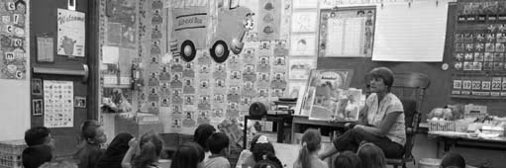
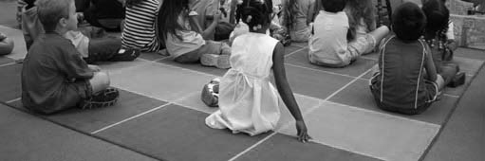
A Day in Kindergarten
1
In Keesha’s kindergarten classroom, the day started with meeting time. The children sang a song each day.
2
They also talked about the weather. Next, they had show-and-tell. Today Tim talked about his toy spaceship. He passed it around for everyone to see.
3
Then it was reading time. The letter of the week was d, so Ms. Clarke read a book about dolphins.
4
The children had time to draw pictures. Keesha drew a picture of her favorite animal. It was a dolphin!
"Copyright HaveFunTeaching.com"

Slide 10
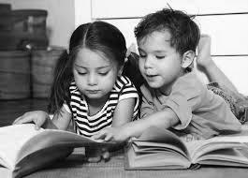
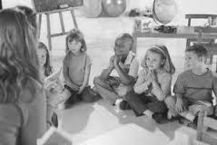
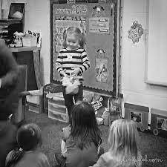
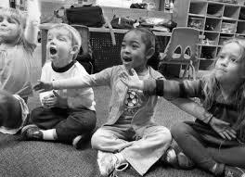
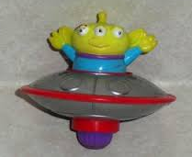
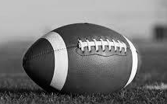
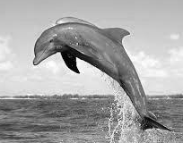
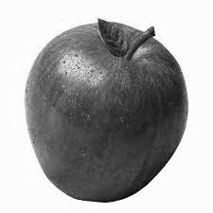
Selected Response Questions
Literary Passage: A Day in Kindergarten
1.
2.
3.
4. Why did Ms. Clarke read a story about dolphins?
5.
6. Why do you think Keesha drew what she did?

Slide 11
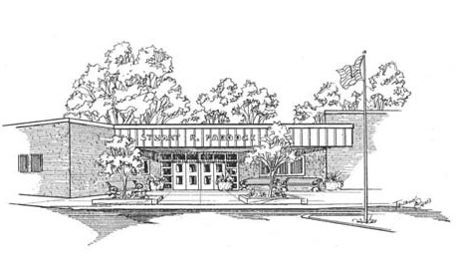
Time for School
There are things you can do to get ready for school.
"Copyright HaveFunTeaching.com"

Slide 12

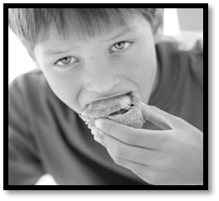
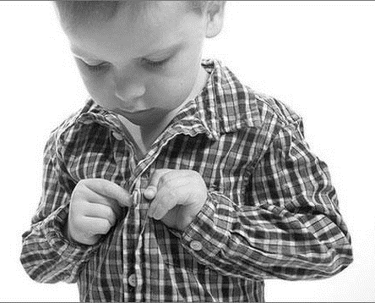
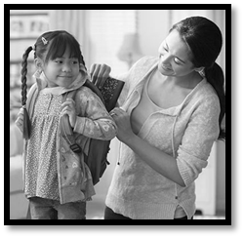
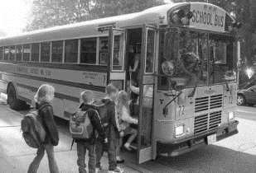
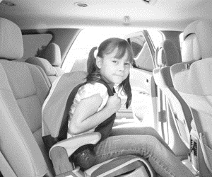
Eating a good breakfast will help you learn better.
Wearing clothes that are comfortable is important.
Some boys and girls wait for the school bus. Others ride to school with family or friends.
Having backpacks ready each morning will make it so you don’t have to rush.
"Copyright HaveFunTeaching.com"

Slide 13
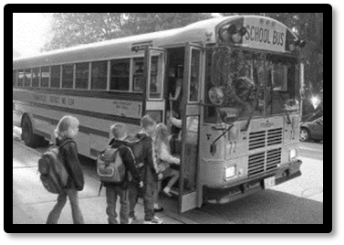
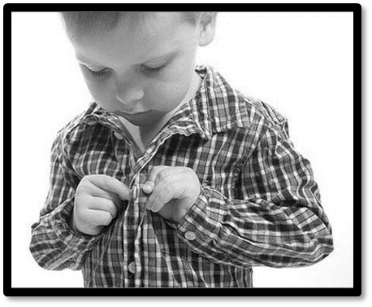
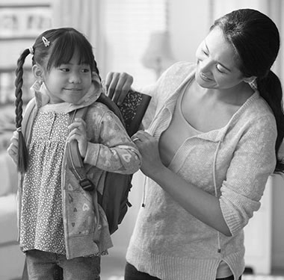
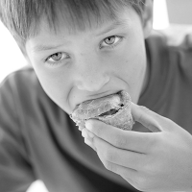
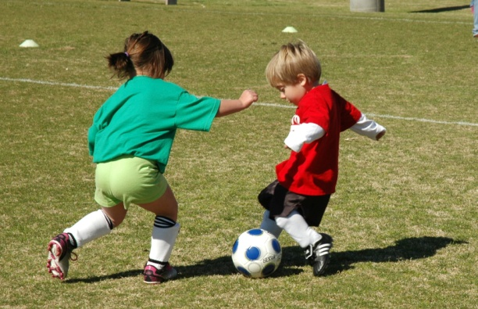
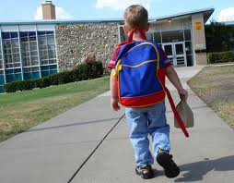
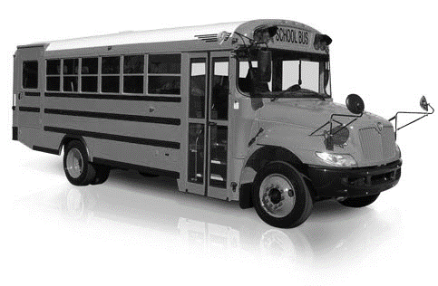
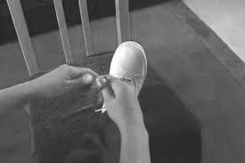
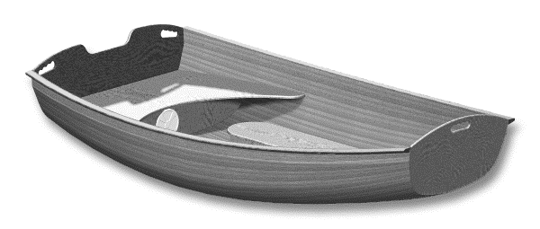

Student Page for Selected Response Questions
Informational Passage: Time for School
7.
8.
9. Look at the pictures above. Tell what happened first, next and last in the story. Point to the pictures as you tell about the story.
10.
11.
12.

Slide 14
Grade
K
Student QTR 1 Pre-Assessment
Listening Comprehension
Name________________________

Slide 15
Kindergarten Quarter 1 Pre-Assessment Student Check-list Directions: Read each question to the student. Put a check mark by the answer the student gives. The correct answers are highlighted in bold.
Literary Passage: A Day in Kindergarten
1 | Summarize a sequence of events from a text read to in class. DOK-2 Ci RL.K.1 Prompt: How did each day begin in Keesha’s class? reading time_________ meeting time________
2 | Answers and asks questions referring to specific details. DOK-2 Cl RL.K.1 Prompt: When do the boys and girls get to tell about something they brought from home? Show and Tell _________ Singing Songs______
3 | Summarizes a familiar story read to in class using key details. DOK-2 Ci RL.K.2 Prompt: Which pictures tell about the story? toy spaceship____ football______ dolphin______
4 | Locates key details in order to answer questions about a familiar story. DOK-2 Cl RL.K.2 Prompt: Why did Ms. Clark read a story about dolphins? Answer should be: The letter of the week was “D”
5 | Answer describing questions about characters, setting or events in a story read and discussed in class. DOK-1 Cf RL.K.2 Prompt: What did Keesha draw? an apple ______ a dolphin ________
6 | Connects story events to a specific character or setting. DOK-2 Ch RL.K.3 Prompt: Why do you think Keesha drew what she did? Answer in some way: We read about a dolphin.
Informational Passage: Time for School
7 | Summarize a sequence of events. DOK-2 Ci RI.K.1 Prompt: Which picture shows what happened first ? getting off the bus____ getting dressed __________
8 | Answers and asks questions referring to specific details in a text. DOK-2 Cl RI.K.1 Prompt: Which picture shows something the story says should be ready each morning so there is no rushing. backpack_______ breakfast________
9 | Summarize key details of a text (beginning, middle and ending DOK-2 Ck RI.K.2 Prompt: Tell what happened first, next and last in the story. Point to the pictures when you tell about the story. Tells the first part ________ tells the next parts __________ tells the end part ________
10 | Identify details that support the main topic of a text. DOK-2 Cl RI.K.2 Prompt: Which pictures are like the story Time for School ? bus____ soccer_____ backpack_____
11 | Explains connections between cause and effect of events. DOK-2 Ch RI.K.3 Prompt: What can help you learn better at school? eating breakfast _____ tying your shoe _____
12 | Categorizes when events happened or how events are the same and different. DOK-3 ANp RI.K.3 Prompt:: In the story Time for School how can boys and girls get to school? by boat or car ___ by bus or car ___
Each correct selected response is one point.
1 | 2 | 3 | 4 | 5 | 6 | 7 | 8 | 9 | 10 | 11 | 12
/1 | /1 | /1 | /1 | /1 | /1 | /1 | /1 | /1 | /1 | /1 | /1
Total Listening Comprehension _____/ 12 For students needing support with any one standard, please refer to your grade-level Reading Learning Progressions for instructional tasks and differentiation.

Slide 16
This self-reflection sheet is applicable for grades 1 – 6. In kindergarten it can be used for teacher-student reflection, parent conferencing, an assessment record or whichever way is most applicable to the teacher.
Literary Text
1 | I can summarize first, next and last in a story. RL.K.1
2 | I can ask and answer questions about the details. RL.K.1
3 | I can summarize the most important parts of a story. RL.K.2
4 | I can tell what a text is mostly about. RL.K.2
5 | I can answer describing questions about a story. RL.K.3
6 | I can tell what a character did. RL.K.3
Informational Text
7 | I can tell when something happened in a story. RI.K.1
8 | I can find details in the story to show what I know. RI.K.1
9 | I can summarize key details of a text (retell). RI.K.2
10 | I can identify details in a text that support a main topic. RI.K.2
11 | I can tell what caused something to happen (connecting ideas) RI.K.3
12 | I can group together “when” things happened in a story. RI.K.3

