Slide 1
Tools for Teachers:
Close Reading and Text Dependent
Questions

Slide 2
Session Objectives
As a result of this session, participants will…
Learn about the reading strategy called “close reading” as a means of teaching complex text.
Examine the characteristics of text-dependent questions.
Learn how to employ a structured process to create text-dependent questions at the word/phrase, sentence, and paragraph/passage levels.
Understand the connections between effective close reading and the CCSS Anchor Reading Standards.
Learn how to employ a structured process to evaluate and revise existing reading comprehension questions in current curriculum.

Slide 3
Key Shifts in the Standards

Slide 4
Reading Complex Texts In-Depth
Students can build knowledge through close reading of materials facilitated by text-dependent questions that require evidence drawn from what they have read.

Slide 5
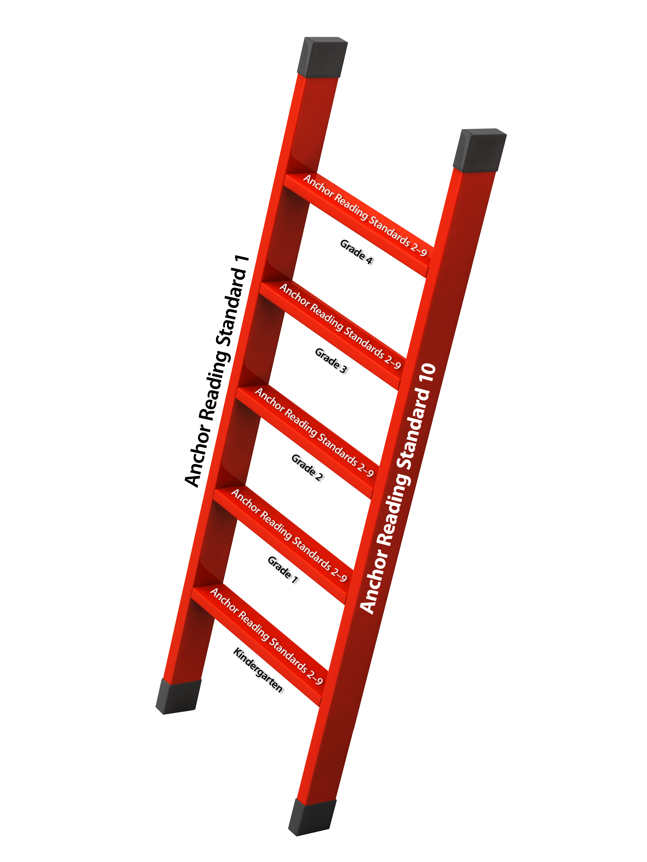
“Close Reading” and Anchor Reading Standards
The CCSS Anchor Reading Standards:
Prioritize the “close reading” skills of extracting evidence and making inferences (Standard 1) when reading complex text (Standard 10).
Frame the performance of the intervening Anchor Standards 2-9 as relying on the central “close reading” skill of citing specific textual evidence from complex text.
Create a ladder that students must climb to demonstrate college and career readiness.
Notes:
Direct them to the first handout – Principles Informing Close Reading – end 8:30

Slide 6
Why focus on “close reading”?
“One of the key requirements of the Common Core State Standards for Reading is that all students… must be able to read and comprehend independently and proficiently the kinds of complex texts commonly found in college and careers.”
--CCSS Appendix A, pg. 2
In the context of an “effective, comprehensive reading program designed to develop proficient readers with the capacity to comprehend texts across a range of types and disciplines (CCSS ELA & Literacy, pg. 15),” “close reading” instruction facilitated by a skilled teacher is one of many research-based strategies that can help students become independent and proficient readers of increasingly complex texts.

Slide 7
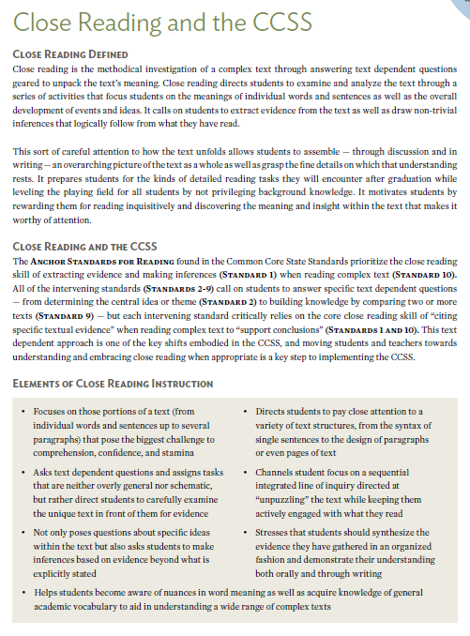
Why Depth through
“Close Reading” Matters
Close reading instruction:
Motivates students by rewarding them for reading inquisitively.
Requires careful attention to how the text unfolds through asking text-dependent questions.
Focuses on building knowledge through the strategic use of text-dependent questions.
Can prepare students for the kinds of reading tasks they will encounter after graduation.

Slide 8
Time to Reflect
Educators must become deeply familiar with “close reading” as readers in order to design and deliver effective “close reading” instruction.

Slide 9
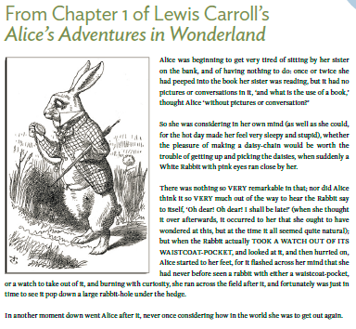
Close Reading of a Sample Text
Notes:
Have them discuss changes from what they do to what Close Reading requires.
Direct them to the first handout – Principles Informing Close Reading – end 8:30

Slide 10
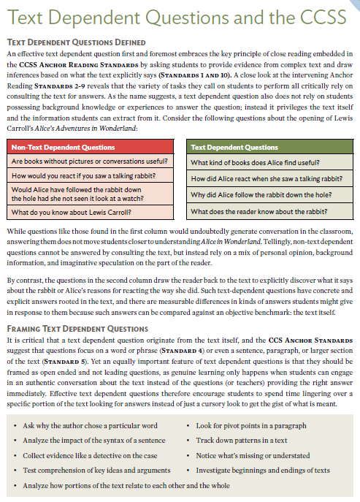
What are Text-Dependent Questions?
Text-dependent questions:
Draw the reader back to the text to discover what it says.
Have concrete and explicit answers rooted in the text.
Frame inquiries in ways that do not rely on a mix of personal opinion, background information, and imaginative speculation.
Notes:
Direct them to the first handout – Principles Informing Close Reading – end 8:30

Slide 11
Differences in Depth:
Text versus Non-Text-Dependent Questions
Non-Text-Dependent Questions | Text-Dependent Questions
Are books without pictures or conversations useful? | What kind of books does Alice find useful?
How would you react if you saw a talking rabbit? | How did Alice react when she saw a talking rabbit?
Would Alice have followed the rabbit down the hole had she not seen it look at a watch? | Why did Alice follow the rabbit down the rabbit-hole?
What do you know about Lewis Carroll? | What does the reader know about the rabbit?
Notes:
Selecting: there’s work to be done beyond identifying lexile scores and grade bands
Sorting: almost all schools are way out of balance with respect to literary and informational text
Share: the equity issues for Els are complex

Slide 12
Creating Text-Dependent Questions
An effective text dependent question delves into a text to guide students in extracting the key meanings or ideas and events found there.
To achieve this end, text dependent questions begin by exploring specific words, details, explanations and arguments.
They then investigate the text through utilizing the Anchor and/or Grade-level Reading Standards to generate the question.

Slide 13
Creating Text-Dependent Questions
Level of Text Specificity | CCS Anchor Standard Close Reading Skill | Text Dependent Question
Words and Phrases | Analyze how specific word choices shape tone (Standard 4) | Why wasn’t Alice “burning with curiosity” when she initially saw the rabbit? What subsequent events led to her feeling this way?

Slide 14
Creating Text-Dependent Questions
Level of Text Specificity | CCS Anchor Standard Close Reading Skill | Text Dependent Question
Sentences | Assess how point of view shapes content (Standard 6) | In the opening paragraph Alice states “what is the use of a book … without pictures or conversation?” What does that sentence reveal about her?

Slide 15
Creating Text Dependent Questions
Level of Text Specificity | CCS Anchor Standard Close Reading Skill | Text Dependent Question
Paragraphs | Summarize key supporting details (Standard 2) | What details about the rabbit catch Alice’s eye in the third paragraph?
 | Investigate the structure of specific sentences, paragraphs, and sections of text (Standard 5) | Around what word does the meaning of the third paragraph pivot? How does that change the initial meaning of the paragraph and channel it in a new direction?

Slide 16
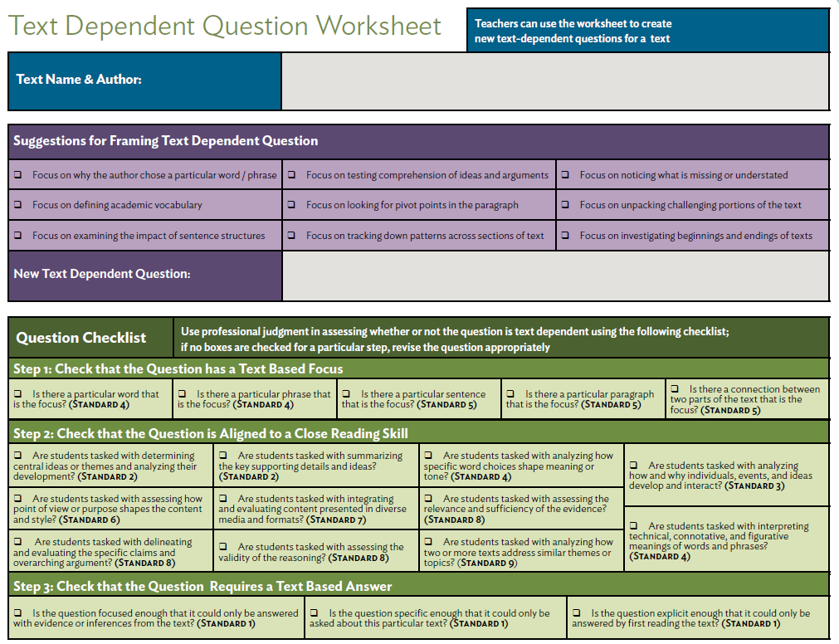
Tools for Creating Text-Dependent Questions:
Text-Dependent Question Worksheet
A systematic approach to creating text- dependent questions for complex texts while aligning them with the demands of the CCSS.

Slide 17
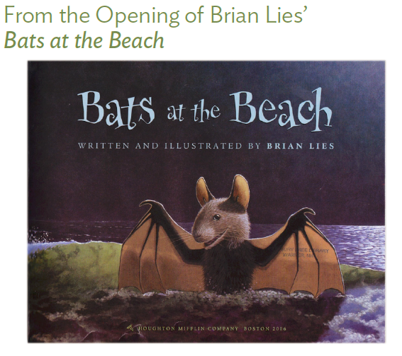
“Close Reading” of a Stand-Alone Text

Slide 18
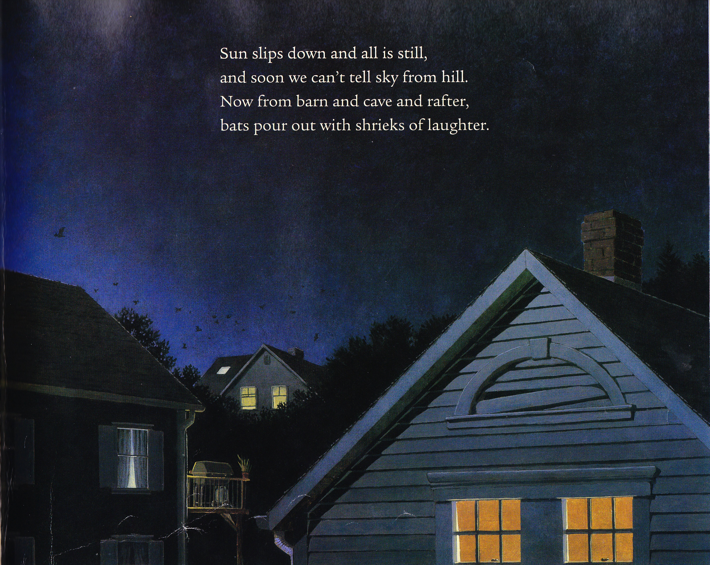

Slide 19
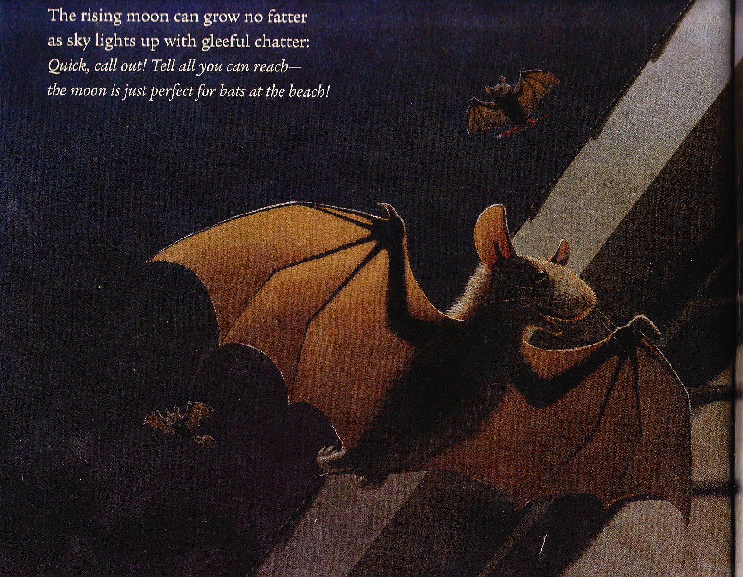

Slide 20
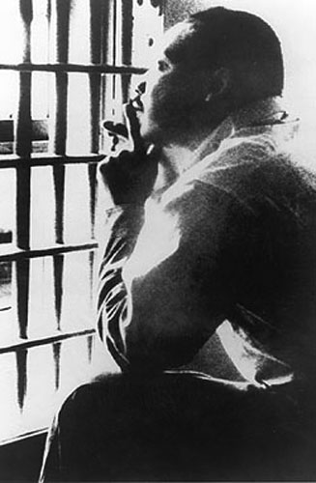
Creating Text-Dependent Questions for Informational Text
From Martin Luther King’s note to “Letter from Birmingham Jail”:
Begun on the margins of the newspaper in which the statement appeared while I was in jail, the letter was continued on scraps of writing paper supplied by a friendly Negro trusty, and concluded on a pad my attorneys were eventually permitted to leave me.

Slide 21
Creating Text-Dependent Questions for Informational Text
From Martin Luther King’s note to “Letter from Birmingham Jail”:
Begun on the margins of the newspaper in which the statement appeared while I was in jail, the letter was continued on scraps of writing paper supplied by a friendly Negro trusty, and concluded on a pad my attorneys were eventually permitted to leave me.

Slide 22
Creating Text-Dependent Questions for Informational Text
From Martin Luther King’s note to “Letter from Birmingham Jail”:
Begun on the margins of the newspaper in which the statement appeared while I was in jail, the letter was continued on scraps of writing paper supplied by a friendly Negro trusty, and concluded on a pad my attorneys were eventually permitted to leave me.

Slide 23
Creating Text-Dependent Questions for Informational Text
From Martin Luther King’s note to “Letter from Birmingham Jail”:
Begun on the margins of the newspaper in which the statement appeared while I was in jail, the letter was continued on scraps of writing paper supplied by a friendly Negro trusty, and concluded on a pad my attorneys were eventually permitted to leave me.

Slide 24
Creating Text-Dependent Questions for Informational Text
From Martin Luther King’s note to “Letter from Birmingham Jail”:
Begun on the margins of the newspaper in which the statement appeared while I was in jail, the letter was continued on scraps of writing paper supplied by a friendly Negro trusty, and concluded on a pad my attorneys were eventually permitted to leave me.

Slide 25
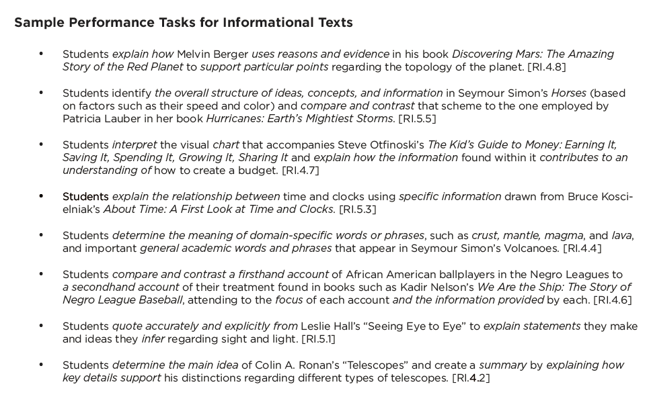
Resources for Text-Dependent Questions:
Appendix B Sample Performance Tasks
Picture of Text Dependent
Questions Worksheet
Notes:
Selecting: there’s work to be done beyond identifying lexile scores and grade bands
Sorting: almost all schools are way out of balance with respect to literary and informational text
Share: the equity issues for Els are complex

Slide 26
Time to Reflect
Effective text-dependent questions ask students to extract evidence from the text to make inferences and draw conclusions based on what the text says explicitly.

Slide 27
Text-Dependent Questions and Basal Readers
Basal reading programs by the four major publishers comprise 80% of all the texts used in elementary and middle school
Most of these texts rely heavily on non-text based pre-reading activities that “digest and regurgitate” the primary text and eliminate the need for close reading…
… which wouldn’t be necessary anyway since most of these basal readers include a high proportion of non-text dependent questions (including the writing prompts for basal texts)…
… and required students to perform multiple tasks that are irrelevant to understanding the text being read (i.e. focus on using comprehension strategies as an end in themselves)

Slide 28
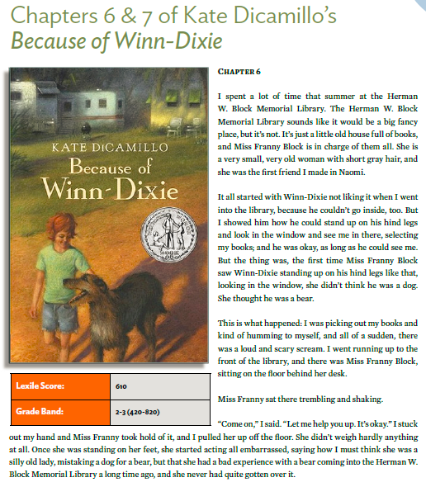
Basal Reader Questions and Real Texts

Slide 29
Basal Reader Questions:
Simple Non-Text-Dependent Questions
Was there ever a time where an animal scared you?
Should Ms. Franny have felt embarrassed?
Can bears really eat people?
Will Opal and Amanda ever be friends?
Explain how reading the story made you feel about visiting a library.

Slide 30
Basal Reader Questions:
Complex Non-Text Dependent Questions
This author has won prizes for her books. Why? Write an opinion column about why this author deserved such recognition.
In Because of Winn-Dixie Opal tells about her experiences after moving to a new town. Think about a time that you were a newcomer to a place or situation. Now use vivid words to write a memoir about that experience.
Visit a library and do research on wildlife and plant life in Florida and how to safeguard libraries from “unwanted visitors.”

Slide 31
Basal Reader Questions:
Trivial Text-Dependent Questions
Why was Miss Franny sitting on the floor when Opal met her?
What book was Miss Franny reading when the bear came into the library?
What did the men say when they were teasing Miss Fanny?
What did Miss Franny say when Amanda asked if dogs were allowed in the library?

Slide 32
Time to Reflect
Students build knowledge through “close reading” of materials facilitated by text-dependent questions that require evidence drawn from what they have read.

